Slide 1
Heaps and heapsort
COMP171
Fall 2005

Slide 2
Motivating Example
3 jobs have been submitted to a printer in the order A, B, C.
Sizes: Job A – 100 pages
Job B – 10 pages
Job C -- 1 page
Average waiting time with FIFO service:
(100+110+111) / 3 = 107 time units
Average waiting time for shortest-job-first service:
(1+11+111) / 3 = 41 time units
Need to have a queue which does insert and deletemin
Priority Queue

Slide 3
Common Implementations
1) Linked list
  Insert in O(1)
  Find the minimum element in O(n),
  thus deletion is O(n)
2) Search Tree (AVL tree, to be covered later)
Insert in O(log n)
Delete in O(log n)
Search tree is an overkill as it does many other operations

Slide 4
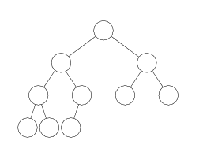
Heaps
Heaps are “almost complete binary trees”
-- All levels are full except possibly the lowest level.
  If the lowest level is not full, then then nodes must be packed to the left.
Note: we define “complete tree” slightly different from the book.

Slide 5
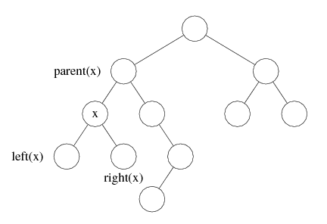
Binary Trees
Has a root at the topmost level
Each node has zero, one or two children
A node that has no child is called a leaf
For a node x, we denote the left child, right child and the parent of x as left(x), right(x) and parent(x), respectively.

Slide 6
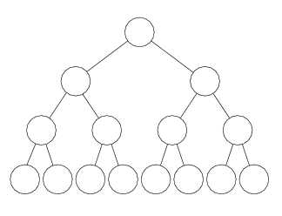
Binary trees
A complete binary tree is one where a node can have 0 (for the leaves) or 2 children and all leaves are at the same depth.
A complete tree
An almost complete tree

Slide 7
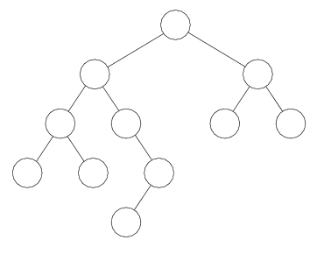
Height (depth) of a binary tree
The number of edges on the longest path from the root to a leaf.
Height = 4

Slide 8
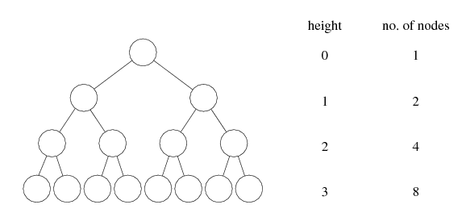
Height of a binary tree
A complete binary tree of N nodes has height O(log N)
d
2^{d}
Total: 2^{d+1} - 1

Slide 9
Proof
Prove by induction that number of nodes at depth d is 2^{d}
Total number of nodes of a complete binary tree of depth d is 1 + 2 + 4 +…… 2^{d} = 2^{d+1} - 1
Thus 2^{d+1} - 1 = N
d = log(N + 1) - 1 = O(log N)
What is the largest depth of a binary tree of N nodes?
N

Slide 10
Coming back to Heap
Heap property: the value at each node is less than or equal to that of its descendants.
1
4
2
5
2
5
4
3
1
3
6
6
A heap
not a heap

Slide 11
Heap
Heap supports the following operations efficiently
  Locate the current minimum in O(1) time
  Delete the current minimum in O(log N) time

Slide 12
Insertion
Add the new element to the lowest level
Restore the min-heap property if violated:
  “bubble up”: if the parent of the element is larger than the element, then interchange the parent and child.

Slide 13
1
2
5
4
3
6
1
Insert 2.5
2
5
4
3
6
2.5
1
Percolate up to maintain the heap property
2
2.5
4
3
6
5

Slide 14
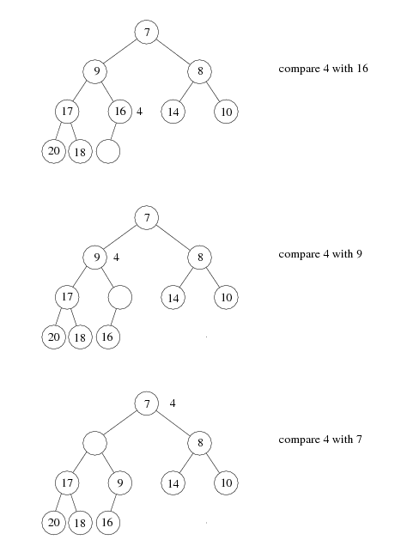
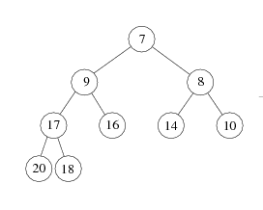
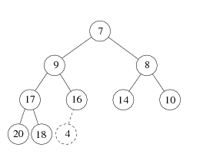

Slide 15
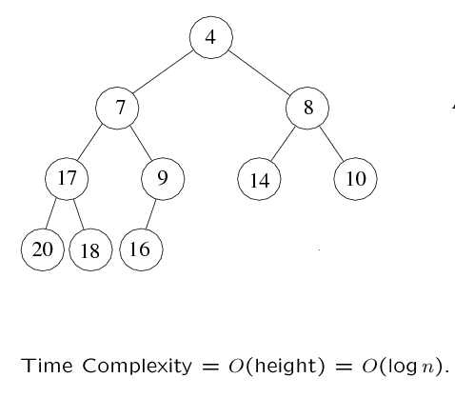
Insertion
A heap!

Slide 16
DeleteMin: first attempt
Delete the root.
Compare the two children of the root
Make the lesser of the two the root.
An empty spot is created.
Bring the lesser of the two children of the empty spot to the empty spot.
A new empty spot is created.
Continue

Slide 17
1
2
5
2
5
4
3
6
4
3
6
2
2
3
5
5
4
3
4
6
6
Heap property is preserved, but completeness is not preserved!

Slide 18
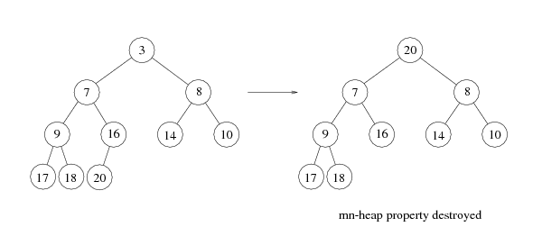
DeleteMin
Copy the last number to the root (i.e. overwrite the minimum element stored there)
Restore the min-heap property by “bubble down”

Slide 19
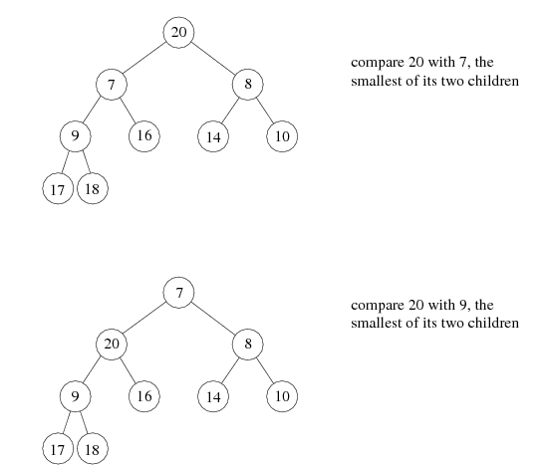

Slide 20
